Slide 1

A Computational Biology Framework
Creating a platform for Biomedical Engineers to improve their data mining efficiency

Slide 2
Contents
Previous reports
Dimensionality Reduction
Techniques
Methods
Datasets
Quality Measurement
Experiment 1 Exploration
Set-up
Results
Experiment 1 Exploration
Set-up
Preliminary Results
General information
Planning
A Computational Biology Framework

Slide 3
Previous reports
Case Study and framework proposal

Slide 4
Previous Reports
Case study
Rewritten with Dragan
Framework Proposal
On hold
First the analysis
A Computational Biology Framework

Slide 5
Dimensionality Reduction
Techniques to reduce the number of features

Slide 6
Dimensionality Reduction
Two types:
Feature extraction
Yet to be done
Feature reduction
Filter methods
Wrapper methods
Embedded methods
A Computational Biology Framework

Slide 7
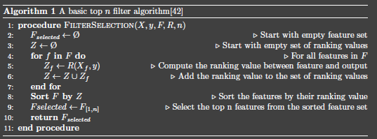
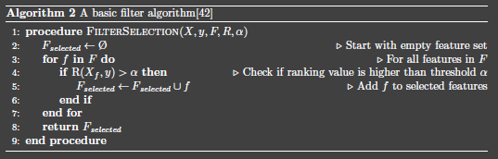
Dimensionality Reduction
Filter methods
Testing separate feature relevance
Ranking method
T-test
Mutual information
Pearson Correlation
Select features
Top n features
Above threshold alpha
A Computational Biology Framework

Slide 8
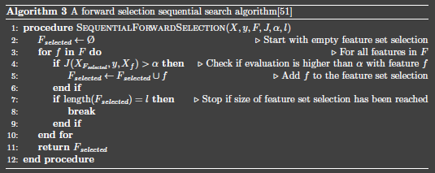
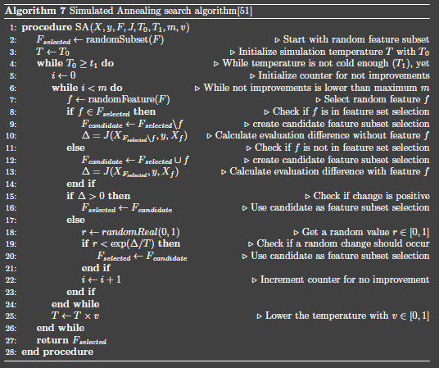
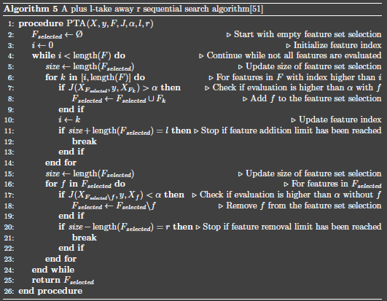
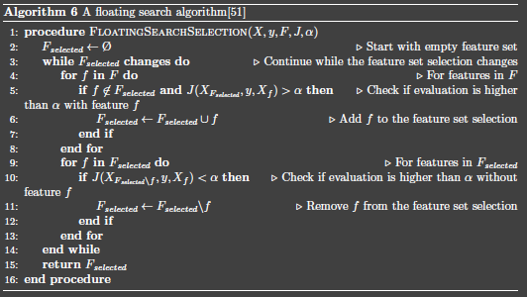
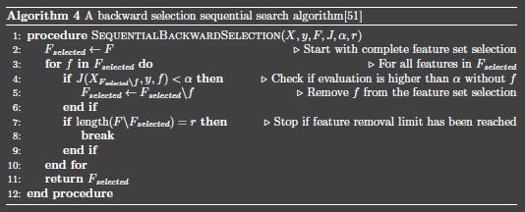
Dimensionality Reduction
Wrapper methods
Iteratively go though features
Sequential search
Forward Selection
Backward Selection
Extended sequential search
Pick l take away r
Floating search
Stochastic search
Simulated Annealing
A Computational Biology Framework

Slide 9
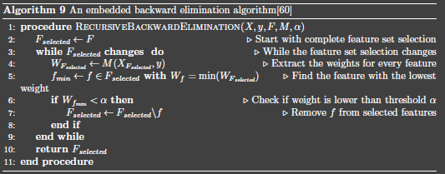
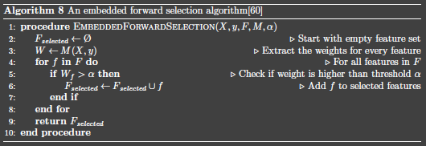
Dimensionality Reduction
Embedded Method
Use of machine learning
Select features by weight
Embedded Forward Selection
Select features by removing worst
Embedded Backward Elimination
A Computational Biology Framework

Slide 10
Dimensionality Reduction
Comparing methods
Filter Methods
Very fast
Still feature dependencies
Wrapper Methods
Slower
Less feature dependencies
Classifier dependent
Embedded Methods
Slower
Classifier dependent
A Computational Biology Framework

Slide 11
Methods
Creating experiments

Slide 12
Methods
Goal
Explore feature selection methods
Use results for framework guidance
Initial set-up
Python with Anaconda distribution
Packages: scikit-learn Numpy, SciPy
A Computational Biology Framework

Slide 13
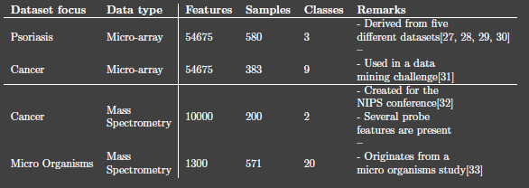
Methods
Datasets
4 datasets
Microarray
Mass spectrometry
Feature reduction beneficial
Different features/samples/classes combinations
A Computational Biology Framework

Slide 14
Methods
Dimensionality reduction quality
Way of describing quality preserved featured
Machine learning
Naïve Bayes
Decision Tree
Logistic Regression
Nearest Neighbour
Support Vector Machines
Classification score: Accuracy
A Computational Biology Framework

Slide 15
Experiment 1 set-up
Feature selection exploration

Slide 16
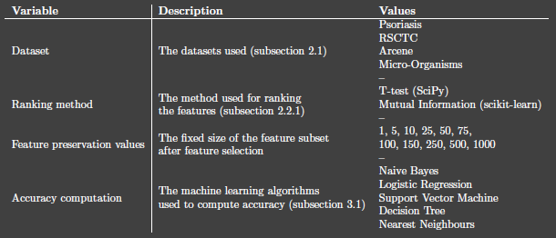
Experiment 1
Feature selection exploration
4 x 2 x 11 x 5 = 440 measurements
Exploration quality measurements
Exploration filter methods
Exploration feature preservation
A Computational Biology Framework

Slide 17
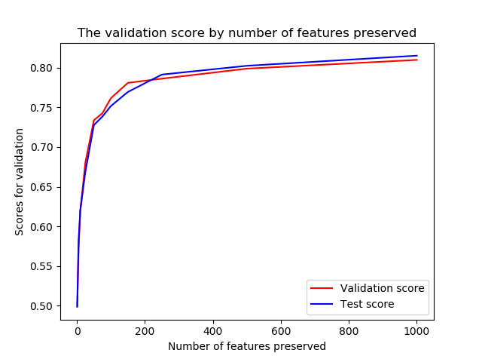
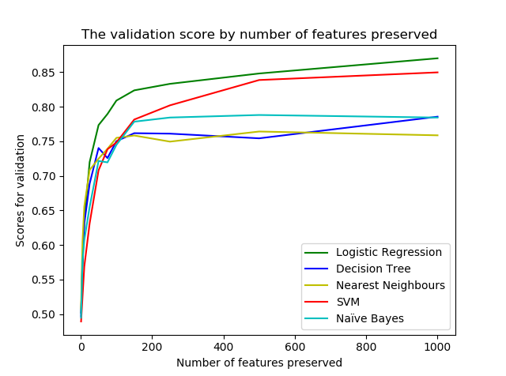
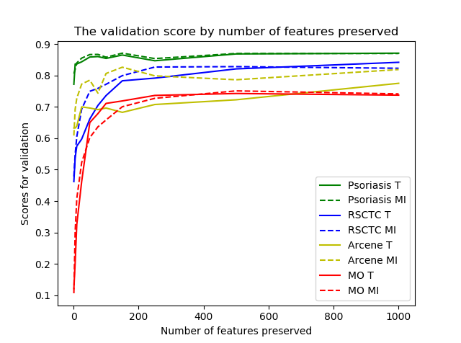
Experiment 1
Results
No overfitting
Logistic regression
‘elbow’
200 features threshold
A Computational Biology Framework

Slide 18
Experiment 2 set-up
Feature selection evaluation

Slide 19
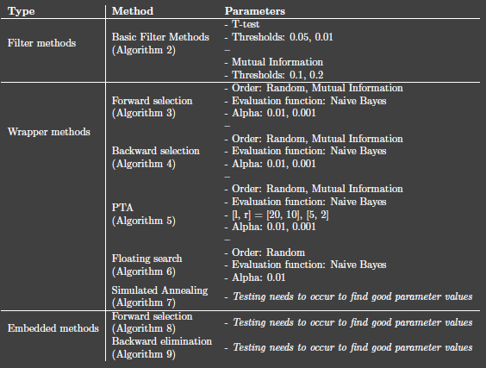
Experiment 2
Feature selection evaluation
Feature selection methods are evaluated
All four datasets
Logistic regression (most consistent experiment 1)
A Computational Biology Framework

Slide 20
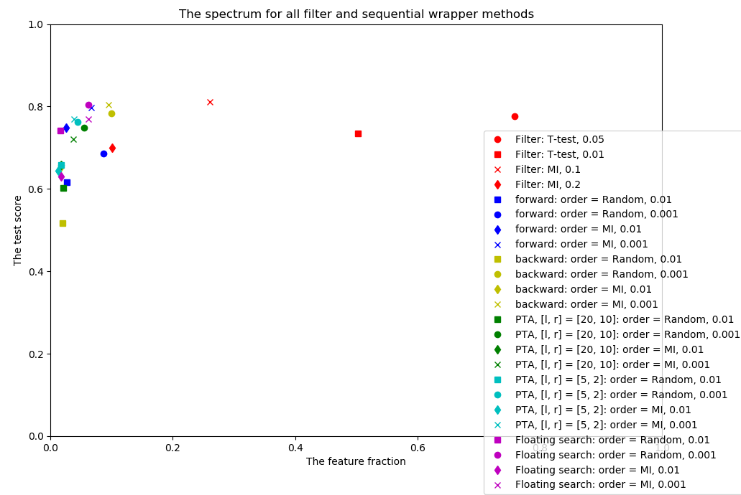
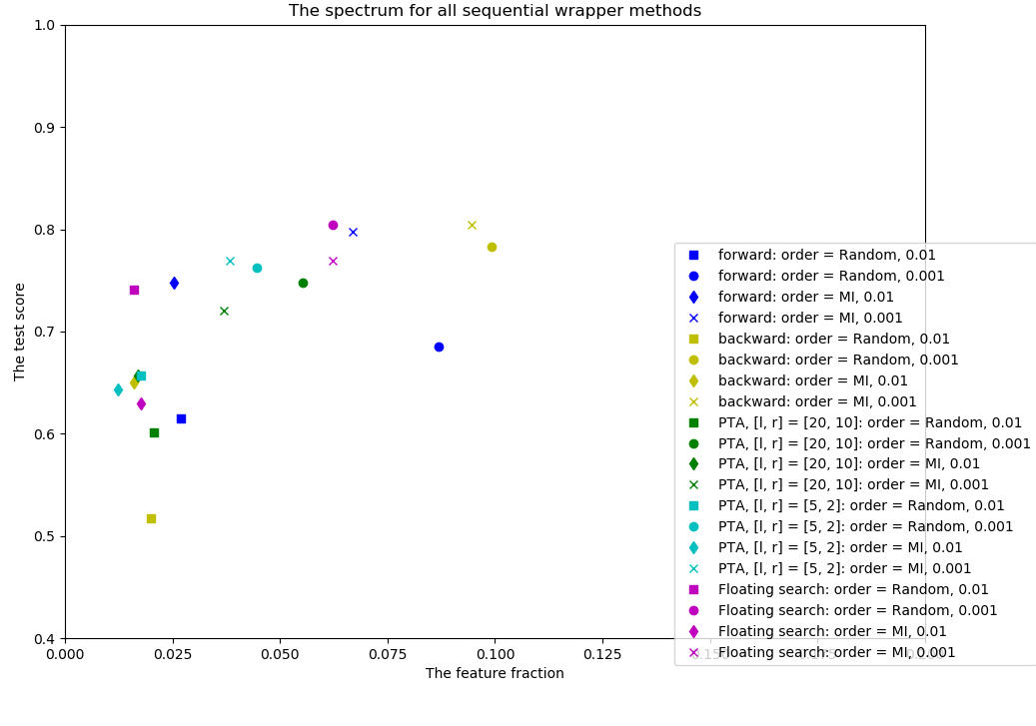
Experiment 2
Results
Wrapper methods
PTA l and r small, floating not ordered and forward ordered
Order mostly
better not floating
Order generates
overfitting
A Computational Biology Framework

Slide 21
General information
What now?

Slide 22
General information
Planning
Dimensionality reduction
Finish up experiment 2
Draw conclusions
Feature extraction
Implement for TPOT
+- 2 weeks/1 month
Next meeting
Friday June 1st
Discuss final dimensionality reduction
Start of data quality enhancement
Own planning
Finished last exam
A Computational Biology Framework

